Slide 1

JS Design Patterns

Slide 2
IIFE
IIFE - Immediately Invoked Function Expressions or Self-executing Anonymous Function
It is a design pattern consisting of two parts:-
The first part is the anonymous function with lexical scope enclosed within “()” (Grouping Operator). This prevents accessing variables within IIFE idiom as well as polluting the global scope.
The second part is creating the immediately executing function expression(), through which JS engine will directly interpret the function.

Slide 3
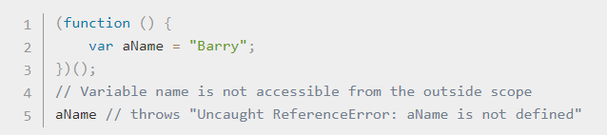
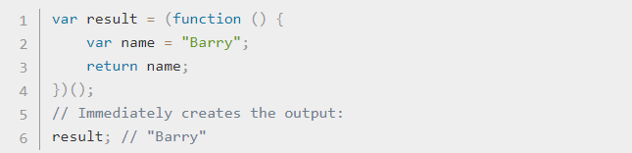
IIFE
Examples:-

Slide 4

Outline
What are Design Patterns?
Why Design Patterns?
What to learn?
Types of Design Patterns
Design patterns in JavaScript
Modern Modular JavaScript Design Patterns
Design Patterns

Slide 5
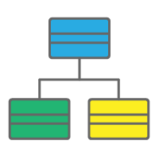
What are Design Patterns?
Are Design Patterns Classes?

Slide 6

What are Design Patterns?
Are Design Patterns Packages?

Slide 7
What are Design Patterns?
Are Design Patterns Libraries?
Libraries

Slide 8
What are Design patterns?
They are NOT classes, packages or libraries that you can plug into your application and WAIT for the MAGIC to happen.
Design patterns are SOLUTIONS to recurring problems, guidelines on how to tackle certain problems.
It is a description or template for how to solve a problem that can be used in many different situations.

Slide 9
What all are the problems you may face while writing code?

Slide 10
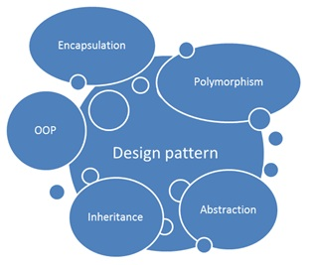
Why design Patterns?
Every developer strives to write code with
Maintainable code
Structured code
Readable code
Reusable code.
Design patterns prove crucial to solve these challenges, providing an organized structure for common issues in a particular circumstance.
Code structuring becomes more important as applications become larger.

Slide 11
Types of design patterns
In software development, design patterns are generally grouped into a few categories.
Creational patterns focus on ways to create objects or classes.
Structural design patterns focus on ways to manage relationships between objects so that your application is architected in a scalable way.
Behavioral patterns focus on communication between objects.

Slide 12
What to learn?
Each pattern consists of many properties, though, we will emphasize the following key points:
Context: Where/under what circumstances is the pattern used?
Problem: What are we trying to solve?
Solution: How does using this pattern solve our proposed problem?
Implementation: What does the implementation look like?

Slide 13

Design patterns in JavaScript
JavaScript web developers frequently interact with design patterns, even unknowingly, when creating applications.
Although there is a diverse list of design patterns used in certain circumstances.
Common issues where design patterns are used in JavaScript
Data Types in JavaScript
Dealing with Privacy

Slide 14
Patterns in Quest
Modern Modular JavaScript Design Patterns
AMD
CommonJs
ECMAScript
ES6, ES7/ES2016,ES 2017

Slide 15
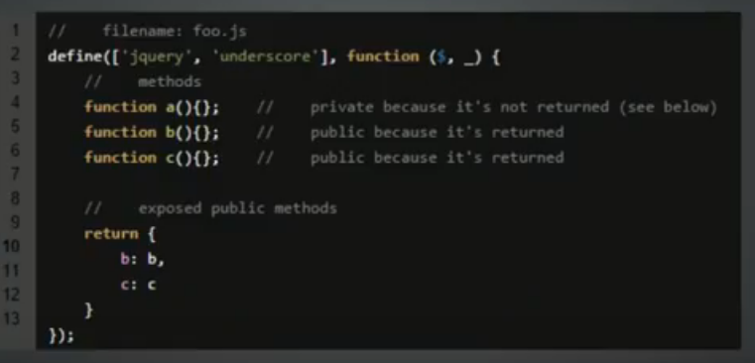


Slide 16
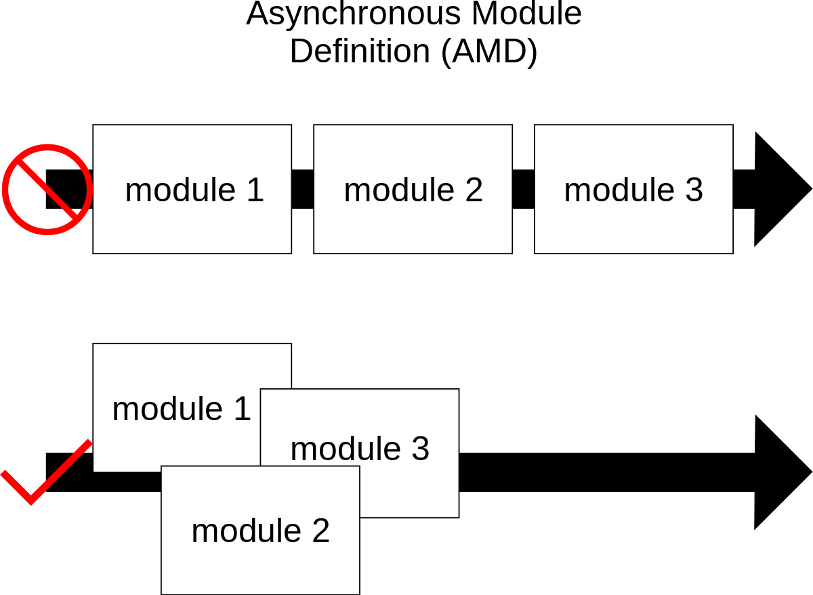
AMD-Asynchronous Module Definition
Implementations of AMD provide the following benefits:
Website performance improvements.
AMD implementations load smaller JavaScript files, and then only when they are needed.
Fewer page errors.
AMD implementations allow developers to define dependencies that must load before a module is executed.

Slide 17
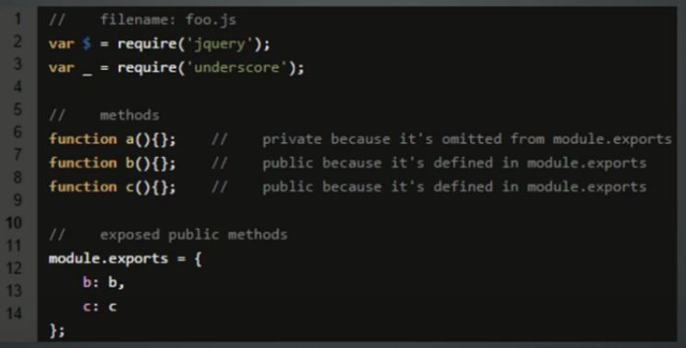


Slide 18

CommonJS
The CommonJS group defined a module format to solve JavaScript scope issues by making sure each module is executed in its own namespace.
To achieve this CommonJS gives you two tools: The require() function, which allows to import a given module into the current scope. The module object, which allows you to export something from the current scope.
Notes:
var Dal = (function () { function Dal() { } Dal.prototype.Add = function () { alert("Dal add called"); }; return Dal; }()); exports.Dal = Dal;

Slide 19
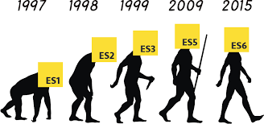
ES Harmony, the the successor to ECMAScript 5
EcmaScript is the standardized scripting language that JavaScript (and some other languages, like ActionScript) implement.
There are quite a few new features in ES6, many still in draft form.
Classes
Arrow Functions
Modules
Block Scoping
Promises

Slide 20
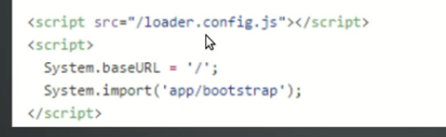


Slide 21
Patterns in Quest
The design patterns in quest include the following:
Constructor
Module
Prototype
Observer
Singleton
Mixin

